Slide 1

Necessity is the Mother of Invention

Slide 2
SUBJECT CODE:SCS1305 SOFTWARE ENGINEERING
UNIT 1 INTRODUCTION
UNIT 2 SOFTWARE ENGINEERING PROCESS
UNIT 3 DESIGN PROCESS AND CONCEPTS
UNIT 4 BASIC CONCEPTS OF SOFTWARE TESTING
UNIT 5 COST ESTIMATION & MAINTENENCE

Slide 3
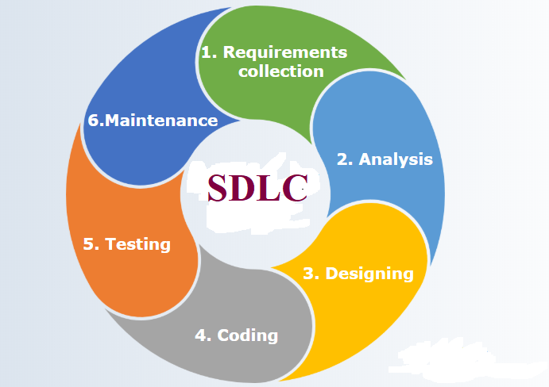

Slide 4
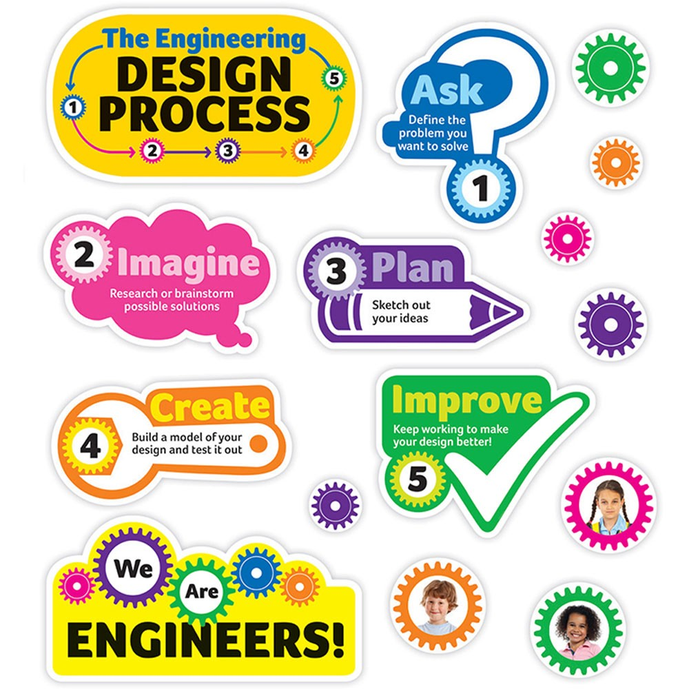

Slide 5
DESIGN PROCESS AND CONCEPTS
UNIT 3

Slide 6
DESIGN PROCESS AND CONCEPTS
Design process
Modular design
Design heuristic
Design model and document
Architectural design
Software architecture
Data design
Architecture data
Transform and transaction mapping
User interface design
User interface design principles

Slide 7
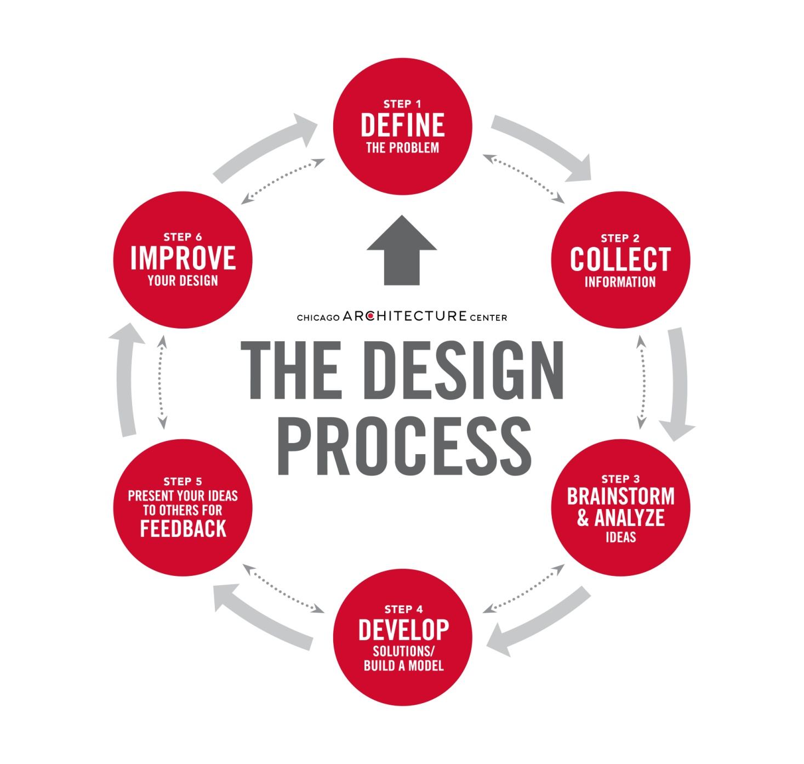
DESIGN PROCESS AND CONCEPTS

Slide 8
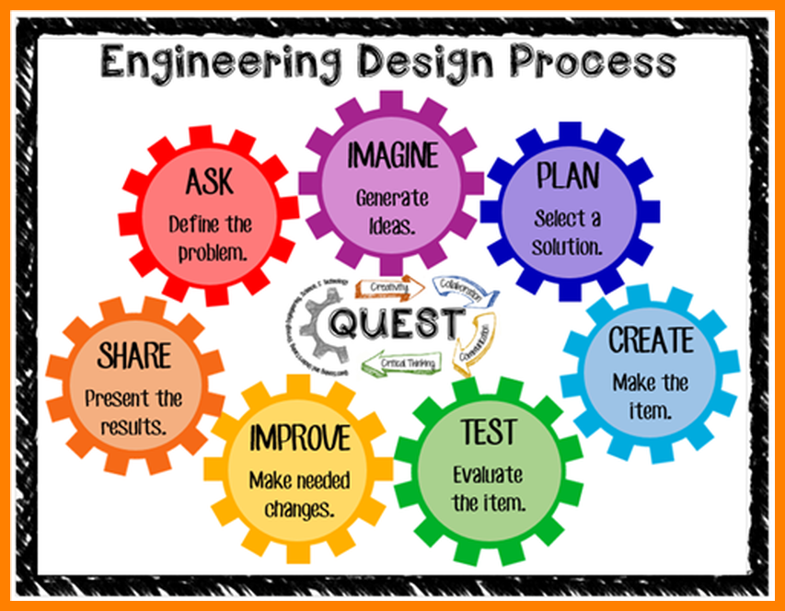

Slide 9
Design process
Software design is a process to transform user requirements into some suitable form, which helps the programmer in software coding and implementation. ..
.Software design is the first step in SDLC (Software Design Life Cycle), which moves the concentration from problem domain to solution domain.

Slide 10
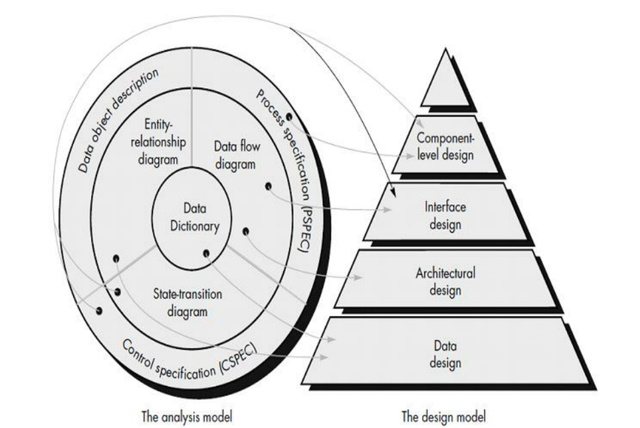
Design process
Analysis model operates as a link between the 'system description' and the 'design model'.
In the analysis model, information, functions and the behavior of the system is defined and these are translated into the architecture, interface and component level design in the 'design modeling'.

Slide 11
DATA DESIGN
The data design transforms the information domain model created during analysis into the data structures that will be required to implement the software.
The data objects and relationships defined in the entity relationship diagram and the detailed data content depicted in the data dictionary provide the basis for the data design activity

Slide 12
ARCHITECTURAL DESIGN
The architectural design defines the relationship between major structural elements of the software, the “design patterns” that can be used to achieve the requirements that have been defined for the system.
The architectural design representation the framework of a computer-based system can be derived from the system specification, the analysis model, and the interaction of subsystems defined within the analysis mode

Slide 13
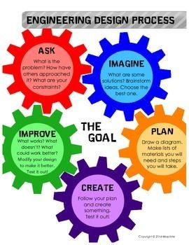

Slide 14
INTERFACE DESIGN
The interface design describes how the software communicates within itself, with systems that interoperate with it, and with humans who use it. data and control flow diagrams provide much of the information required for interface design.

Slide 15
COMPONENT-LEVEL
The component-level design transforms structural elements of the software architecture into a procedural description of software components.
Information obtained from the PSPEC, CSPEC, and STD serve as the basis for component design.
Software Test Description (STD)
Process specification (PSPEC) is used to describe all flow model processes that appear at the final level of refinement.
Control Specifications (CSPEC) (1) how the software behaves when an event or control signal is sensed and
(2) which processes are invoked as a consequence of the occurrence of the event.

Slide 16
The Design Process :
Software design is an iterative process through which requirements are translated into a “blueprint” for constructing the software.

Slide 17
Design and Software Quality
The quality of the evolving design is assessed with a series of formal technical reviews or design walkthroughs McGlaughlin three characteristics that serve as a guide for the evaluation of a good design:
The design must implement all of the explicit requirements contained in the analysis model, and it must accommodate all of the implicit requirements desired by the customer.
The design must be a readable, understandable guide for those who generate code and for those who test and subsequently support the software.
The design should provide a complete picture of the software, addressing the data, functional, and behavioural domains from an implementation perspective.

Slide 18
Design Principles
Design process should not suffer from “tunnel vision”
The design should be traceable to the analysis model
The design should not reinvent the wheel; Time is short
The design should “minimize intellectual distance” between the software and the
problem in the real world
The design should exhibit uniformity and integration
The design should be structured to accommodate change
The design should be structured to degrade gently.
Design is not coding, coding is not design
The design should be assessed for quality as it is being created, not after the fact
The design should be reviewed to minimize conceptual errors

Slide 19
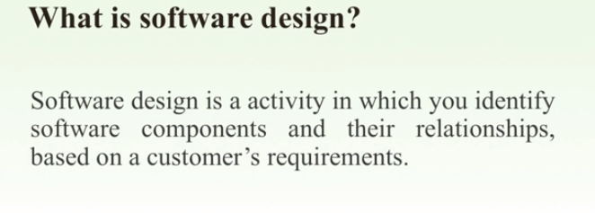
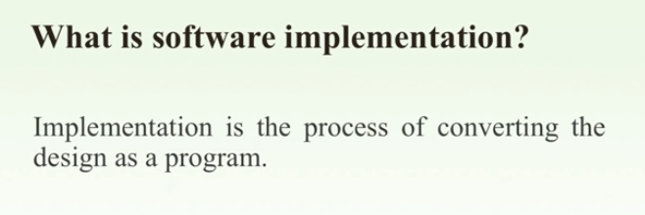

Slide 20
Design Concepts
Fundamental concepts which provide foundation to design correctly:
Abstraction
Refinement
Modularity
Software Architecture
Control Hierarchy
Structural Partitioning
Data Structure
Software Procedure
Information Hiding

Slide 21
Abstraction
Abstraction
Identifying important features for representation
There are many levels of abstraction depending on how detailed the representation is required
Data abstraction - Representation of data objects
Procedural abstraction - Representation of instructions

Slide 22
Refinement
Refinement
Stepwise refinement - top-down design strategy by Niklaus Wirth
Refinement is actually a process of elaboration
Starting at the highest level of abstraction, every step of refinement „decompose‟ instructions into more detailed instructions
Complementary to abstraction

Slide 23
Modularity
Software is divided into separately named and addressable components, often called modules, that are integrated to satisfy problem requirements.
“Divide and conquer” approach - problem is broken into manageable pieces
Solutions for the separate pieces then integrated into the whole system

Slide 24
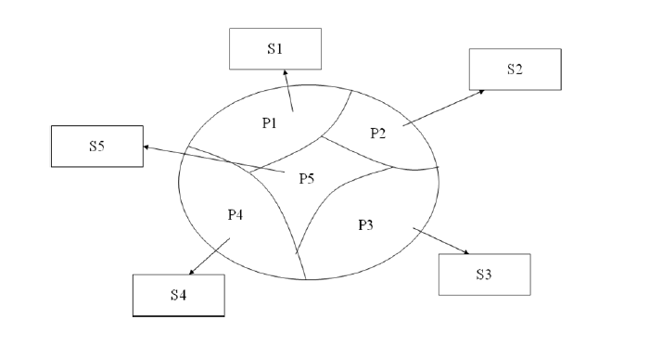
Divide and Conquer

Slide 25
Software Architecture
Modules can be integrated in many ways to produce the system
Software architecture is the overall structure of the software
The hierarchy of components and how they interact, and the structure of data used by the components
Use of framework models, and possible reuse of architectural patterns

Slide 26
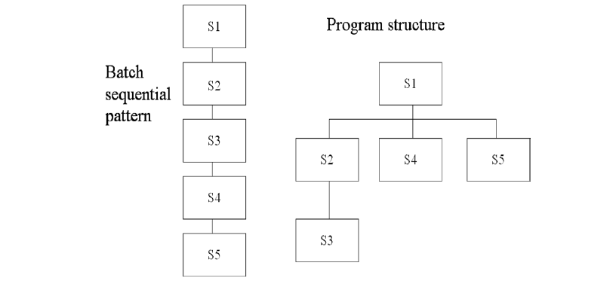

Slide 27
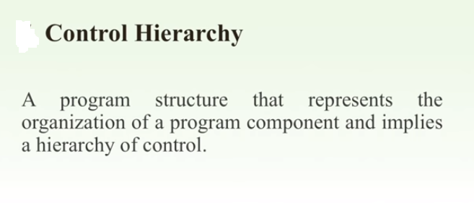
Control Hierarchy

Slide 28
Structural Partitioning
Program structure partitioned horizontally and vertically
Horizontal partitioning defines separate branches for each major program function - input, process, output
Vertical partitioning defines control (decision-making) at the top and work at the bottom

Slide 29
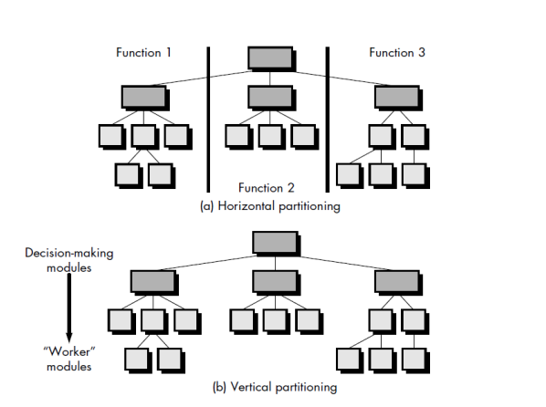
Structural Partitioning

Slide 30
Data Structure
Data structure is a representation of the logical relationship among individual elements of data.

Slide 31
Software Procedure
Processing details of individual modules
Precise specification of processing, including sequence of events, exact decision points, repetitive operations, and data organization/structure
Procedure is layered - subordinate modules must be referenced in processing details

Slide 32
Information Hiding
Information (procedure and data) contained within a module is inaccessible to other modules that have no need for such information
Effective modularity is achieved by independent modules, that communicate only necessary information
Ease of maintenance - testing, modification localized and less likely to propagate

Slide 33
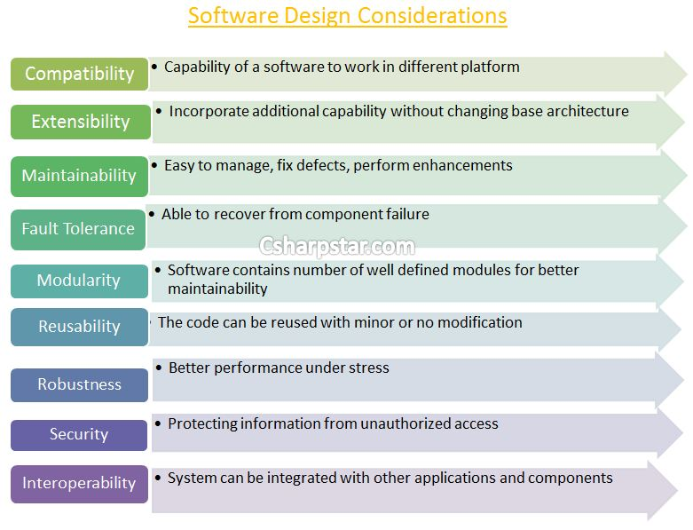
Software design considerations

Slide 34
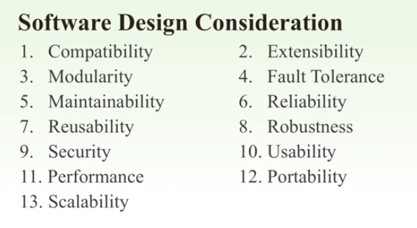
Software design considerations

Slide 35

2. Modular design OR

Slide 36
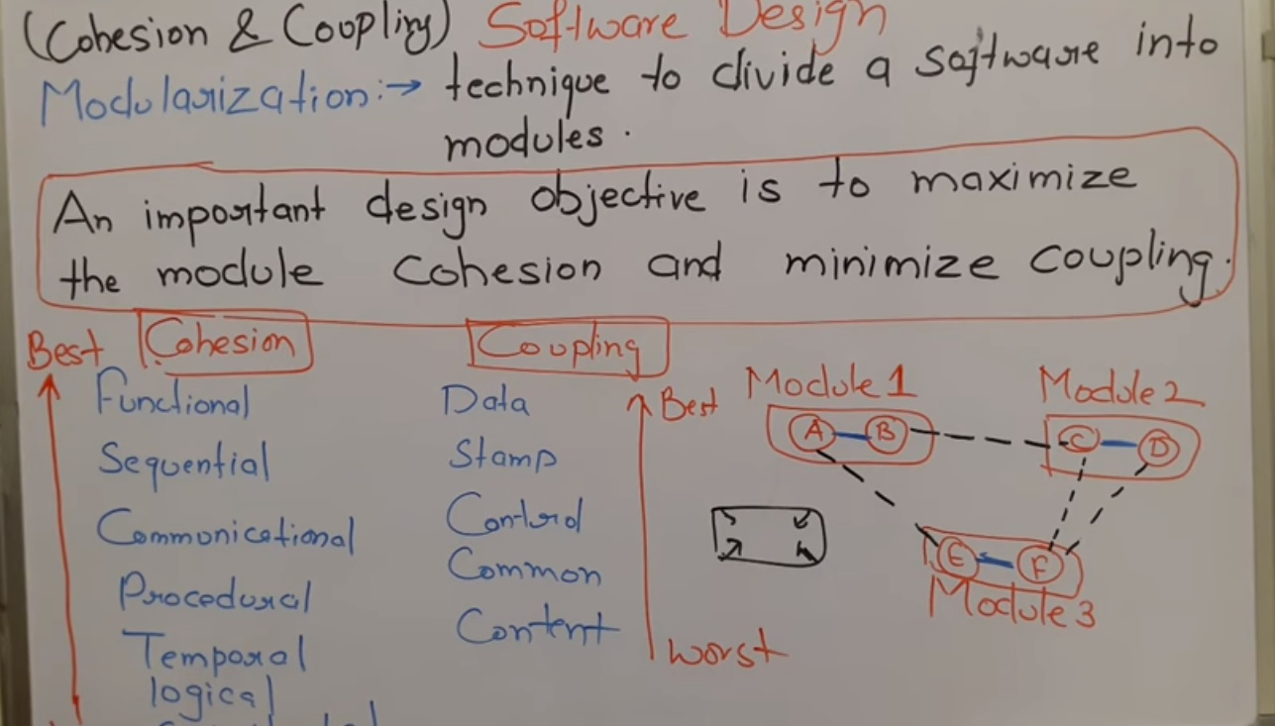

Slide 37
Modular design
Modular design, or "modularity in design", is an approach that subdivides a system into smaller parts called modules or skids, that can be independently created and then used in different systems.

Slide 38
The basic idea underlying modular design is to organize a complex system (such as a large program, an electronic circuit, or a mechanical device) as a set of distinct components that can be developed independently and then plugged together.
Although this may appear a simple idea, experience shows that the effectiveness of the technique depends critically on the manner in which systems are divided into components and the mechanisms used to plug components together.
The following design principles are particularly relevant to parallel programming.

Slide 39
Functional Independence
Designing modules in such a way that each module has specific functional requirements.
Functional independence is measured using two terms cohesion and coupling.

Slide 40
Cohesion
Internal interaction of the module.
Cohesion is a measure of relative functional strength of a module
The degree to which all elements of a component are directed towards a single task and all elements directed towards that task are contained in a single component.

Slide 41
Types of cohesion
Logical Cohesion
Coincidental cohesion
Temporal Cohesion
Procedure Cohesion
Communication Cohesion
Sequential cohesion
Informational cohesion
Functional cohesion

Slide 42
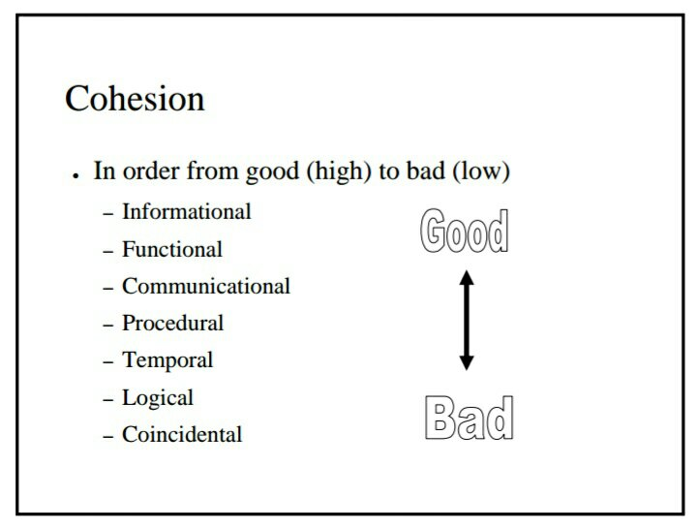

Slide 43
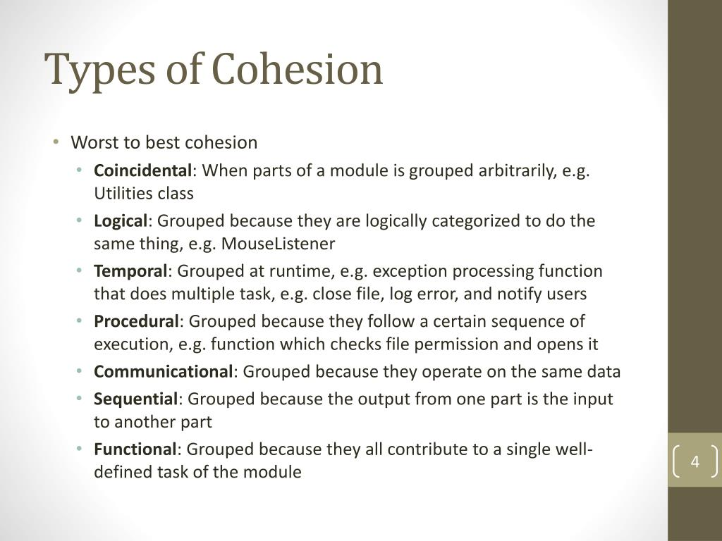

Slide 44
Coupling
In software engineering, coupling is the degree of interdependence between software modules;
A measure of how closely connected two routines or modules are; the strength of the relationships between modules.
Coupling is usually contrasted with cohesion.

Slide 45
Coupling
Coupling is a measure of relative independence among modules, that is it is a measure of interconnection among modules.
Loose coupling means component changes are unlikely to affect other components.
Shared variables or control information exchange lead to tight coupling.

Slide 46
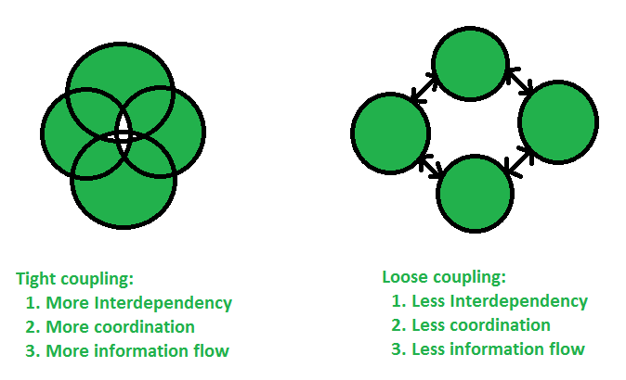
Tight Coupling vs. Loose coupling

Slide 47
Types of coupling
Content coupling
Common Coupling
Control Coupling
Stamp Coupling
Data Coupling

Slide 48
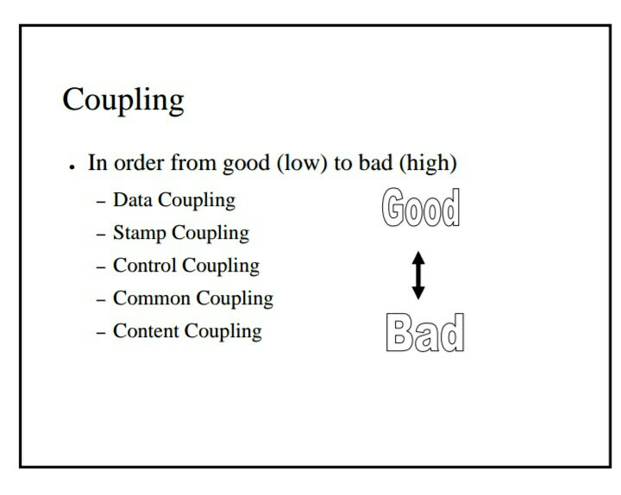

Slide 49
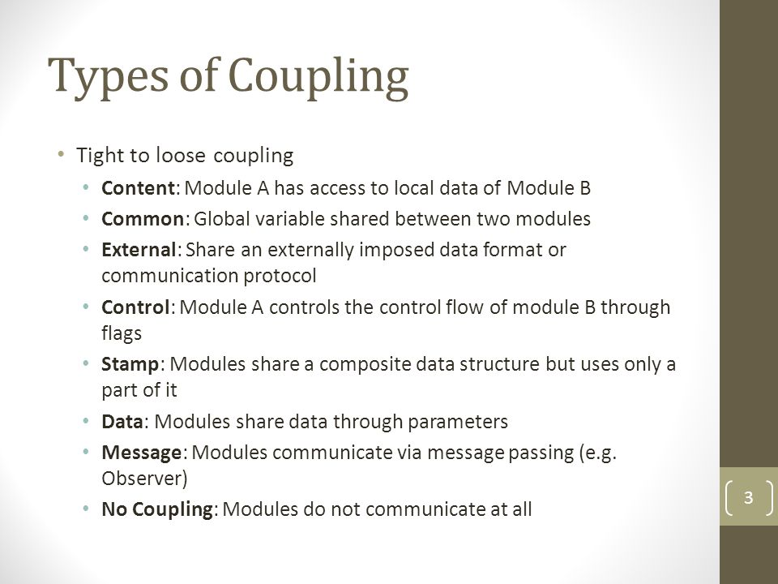

Slide 50
Design heuristic
In computer science, artificial intelligence, and mathematical optimization, a heuristic is a technique designed for solving a problem more quickly when classic methods are too slow, or for finding an approximate solution when classic methods fail to find any exact solution

Slide 51
DESIGN HEURISTIC
Evaluate the first iteration of the program structure to reduce coupling and improve cohesion.
Attempt to minimize structures with high fan-out; strive for fan-in as structure depth increases.
Keep the scope of effect of a module within the scope of control for that module.
Evaluate module interfaces to reduce complexity, reduce redundancy, and improve consistency.
Define modules whose function is predictable and not overly restrictive (e.g. a module that only implements a single sub function).
Strive for controlled entry modules, avoid pathological connection (e.g. branches into the middle of another module)

Slide 52
Architectural Design

Slide 53
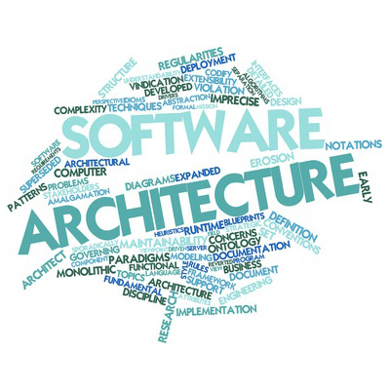

Slide 54
software architecture
It is the structure of software systems
example: A blue print in building architecture
software componets
deatails - (data stectures and algorithms)
relationship among the components
data flow ,control flow ,dependencies
why software architecture?
For 500 - Line Of code(LOC) just write
for 5000-LOC - uses class diagrams (no need of architecture)
for < 5000-LOC- we need Software architecture (bigger programs)

Slide 55
Introduction
The software needs the architectural design to represents the design of software.
IEEE defines architectural design as “the process of defining a collection of hardware and software components and their interfaces to establish the framework for the development of a computer system.”
The software that is built for computer-based systems can exhibit one of these many architectural styles Each style will describe a system category that consists of :

Slide 56
Components or elements or concepts
A set of components(example a database, computational modules) that will perform a function required by the system.
The set of connectors will help in coordination, communication, and cooperation between the components.
Constraints:Conditions that how components can be integrated to form the system.
Semantic models that help the designer to understand the overall properties of the system.

Slide 57
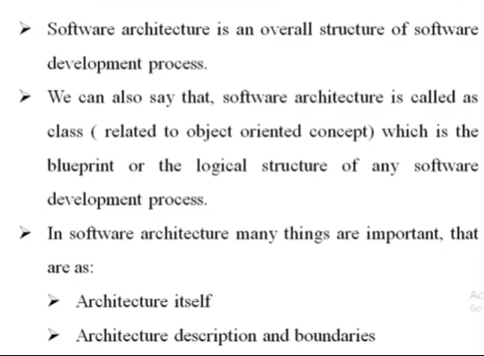
software architecture

Slide 58
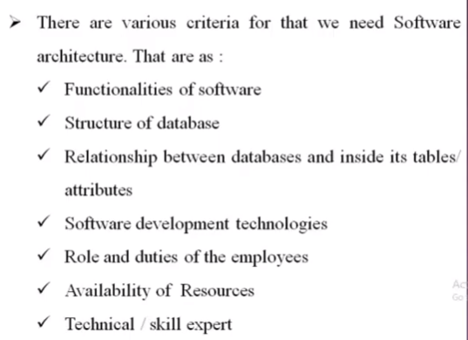
software architecture

Slide 59
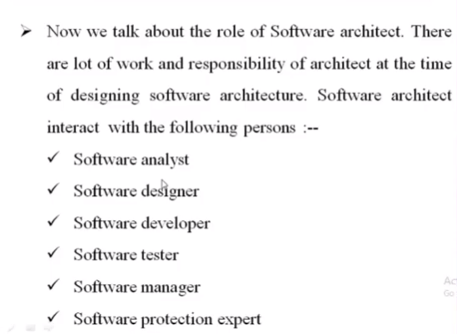
software architecture

Slide 60
Architectural styles
Data centred architectures:
Data flow architectures:
Call and Return architectures:
Object Oriented architecture:
Layered architecture:

Slide 61
Data centred architectures
A data store will reside at the center of this architecture and is accessed frequently by the other components that update, add, delete or modify the data present within the store.
The figure illustrates a typical data centered style. The client software access a central repository.
Variation of this approach are used to transform the repository into a blackboard when data related to client or data of interest for the client change the notifications to client software.
This data-centered architecture will promote integrability.
This means that the existing components can be changed and new client components can be added to the architecture without the permission or concern of other clients.
Data can be passed among clients using blackboard mechanism.

Slide 62
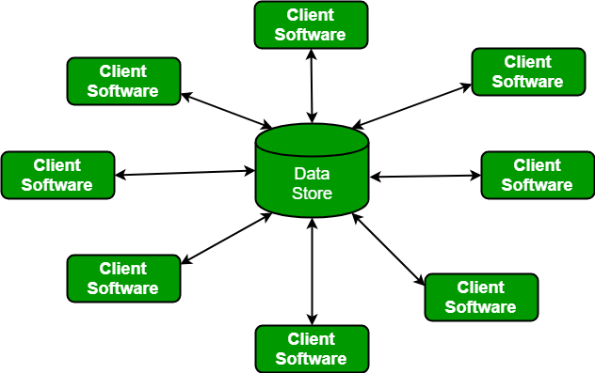
Data centred architectures

Slide 63
Data flow architectures:
This kind of architecture is used when input data to be transformed into output data through a series of computational manipulative components.
The figure represents pipe-and-filter architecture since it uses both pipe and filter and it has a set of components called filters connected by pipes.
Pipes are used to transmit data from one component to the next.
Each filter will work independently and is designed to take data input of a certain form and produces data output to the next filter of a specified form. The filters don’t require any knowledge of the working of neighboring filters.
If the data flow degenerates into a single line of transforms, then it is termed as batch sequential. This structure accepts the batch of data and then applies a series of sequential components to transform it.

Slide 64
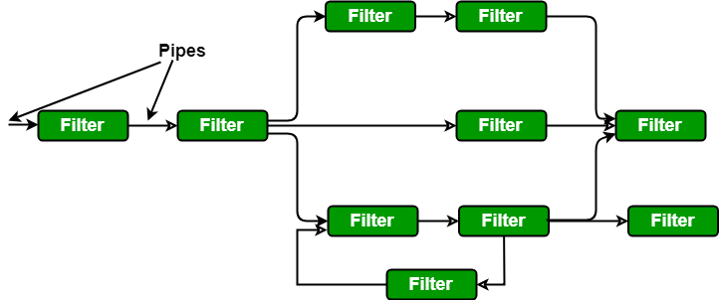
Data flow architectures

Slide 65
Call and Return architectures
Call and Return architectures: It is used to create a program that is easy to scale and modify. Many sub-styles exist within this category. Two of them are explained below.
Remote procedure call architecture: This components is used to present in a main program or sub program architecture distributed among multiple computers on a network.
Main program or Subprogram architectures: The main program structure decomposes into number of subprograms or function into a control hierarchy. Main program contains number of subprograms that can invoke other components.

Slide 66
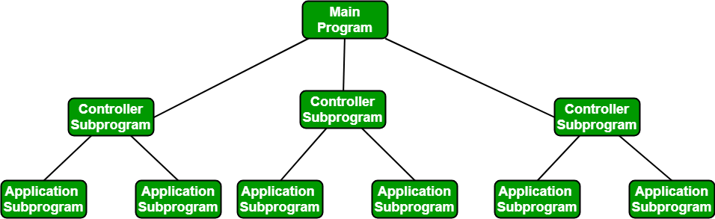
Call and Return architectures

Slide 67
Object Oriented architecture:
The components of a system encapsulate data and the operations that must be applied to manipulate the data.
The coordination and communication between the components are established via the message passing.

Slide 68
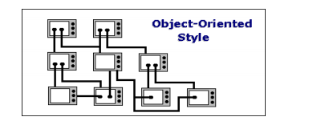
Object Oriented architecture

Slide 69
Layered architecture:
A number of different layers are defined with each layer performing a well-defined set of operations. Each layer will do some operations that becomes closer to machine instruction set progressively.
At the outer layer, components will receive the user interface operations and at the inner layers, components will perform the operating system interfacing(communication and coordination with OS)
Intermediate layers to utility services and application software functions.

Slide 70
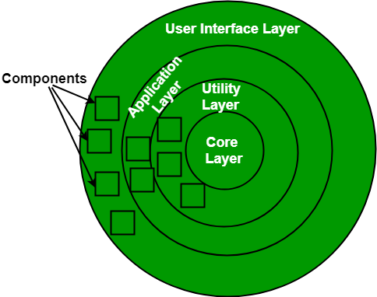
Layered architecture

Slide 71
Transform & Transaction Mapping

Slide 72
Transform mapping
This process of converting a real-life situation (termed as system in software engineering) with flow of data to a DFD is called transform mapping.
Transform mapping is a technique in which Data Flow Diagrams (DFD's) are mapped to a specific scenario. It is a data flow-oriented mapping technique that uses DFDs to map real life scenarios to a software architecture.

Slide 73
An Architectural Design Method
customer requirements
"four bedrooms, three baths,
lots of glass ..."
architectural design

Slide 74
Deriving Program Architecture
Program
Architecture

Slide 75
Partitioning the Architecture
“horizontal” and “vertical” partitioning are required

Slide 76
Horizontal partitioning &vertical partitioning
Horizontal partitioning partitions or segments rows into multiple tables with the same columns.
Vertical partitioning segments columns into multiple tables containing the same rows.

Slide 77
Horizontal Partitioning
Horizontal partitioning partitions or segments rows into multiple tables with the same columns.
define separate branches of the module hierarchy for each major function
use control modules to coordinate communication between functions
function 1
function 3
function 2

Slide 78
Vertical Partitioning: Factoring
Vertical partitioning segments columns into multiple tables containing the same rows
design so that decision making and work are stratified (arrange or classify.)
decision making modules should reside at the top of the architecture
decision-makers
workers

Slide 79
Why Partitioned Architecture?
results in software that is easier to test
leads to software that is easier to maintain
results in propagation of fewer side effects
results in software that is easier to extend

Slide 80
Structured Design
objective: to derive a program architecture that is partitioned
approach:
the DFD is mapped into a program architecture
the PSPEC and STD are used to indicate the content of each module
notation: structure chart

Slide 81
Flow Characteristics
Transform flow - overall data flow is sequential and flows along a small number of straight line paths
Transaction flow - a single data item triggers information flow along one of many paths.
Transform flow
transaction
action paths
transaction centre
Transaction
flow

Slide 82
General Mapping Approach
isolate incoming and outgoing flow
boundaries; for transaction flows, isolate
the transaction center
working from the boundary outward, map
DFD transforms into corresponding modules
add control modules as required
refine the resultant program structure
using effective modularity concepts

Slide 83
Transform Mapping (Analysis)
Transform analysis is a set of design steps that allows a DFD with transform flow
characteristics to be mapped into specific architectural style. These steps are as follows:
Step1: Review the fundamental system model
Step2: Review and refine DFD for the SW
Step3: Assess the DFD in order to decide the usage of transform or transaction flow.
Step4: Identify incoming and outgoing boundaries in order to establish the transform center.
Step5: Perform "first-level factoring".
Step6: Perform "second-level factoring".
Step7: Refine the first-iteration architecture using design heuristics for improved SW quality

Slide 84
Transform Mapping

Slide 85
Factoring

Slide 86
First Level Factoring
main
program
controller
input
processing
output
controller
controller
controller

Slide 87
Second Level Mapping

Slide 88
Transaction Flow
incoming flow
action path
T

Slide 89
Transaction Example
fixture setting
fixture
servos
commands
operator
process
report
operator
display
commands
screen
robot control
robot
control
software
assembly
record
in reality, other
commands
would also be shown

Slide 90
Refining the Analysis Model
1.
write an English language processing narrative
for the level 01 flow model
2.
apply noun/verb parse to isolate processes, data
items, store and entities
3.
develop level 02 and 03 flow models
4.
create corresponding data dictionary entries
5.
refine flow models as appropriate
... now, we're ready to begin design!

Slide 91
Deriving Level 1
narrative for " process operator commands“ after noun-verb parse
Process operator command software reads operator commands from the cell operator. An error message is displayed for invalid commands. The command type is determined for valid commands and appropriate action is taken. When fixture commands are encountered, fixture status is analysed and a fixture setting is output to the fixture servos. When a report is selected, the assembly record file is read and a report is generated and displayed on the operator display screen. When robot control switches are selected, control values are sent to the robot control system.

Slide 92
Level 1 Data Flow Diagram
operator
commands
Error msg
fixture
status
servos
read
operator
commands
analyse
fixture setting
valid command
fixture
fixture
status
determine
command
select report
type
generate
report
control
report
display
robot
screen
send
control
assembly
value
record
robot
control
robot control
system

Slide 93
Level 2 Data Flow Diagram
command
error msg
produce
error
msg
status
format
read
command
determine
setting
fixture setting
command
invalid command
setting
validate
read
raw setting
command
fixture
combined
determine
status
status
type
robot control
read
record
record
calculate
send
output
values
control
values
format
report
value
report
assembly
record
start /stop

Slide 94
Transaction Mapping (Analysis)
Similar to ‘transform mapping’, transaction analysis makes use of DFDs diagrams to establish the various transactions involved and producing a structure chart as a result.
Transaction mapping Steps:
• Review the fundamental system model
• Review and refine DFD for the SW
• Assess the DFD in order to decide the usage of transform or transaction flow.
• Identify the transaction center and the flow characteristics along each action path
• Find transaction center
• Identify incoming path and isolate action paths
• Evaluate each action path for transform vs. transaction characteristics
• Map the DFD in a program structure agreeable to transaction processing
• Carry out the ‘factoring’ process
• Refine the first iteration p

Slide 95
Transaction Mapping Principles
isolate the incoming flow path
define each of the action paths by looking for
the "spokes of the wheel"
assess the flow on each action path
define the dispatch and control structure
map each action path flow individually

Slide 96
Transaction Mapping

Slide 97
Isolate Flow Paths
command
error msg
produce
error
msg
status
format
read
command
invalid command
determine
setting
fixture setting
command
setting
validate
read
raw setting
command
fixture
combined
determine
status
status
type
robot control
read
record
record
calculate
send
output
values
control
values
format
report
value
report
assembly
record
start /stop

Slide 98
Map the Flow Model
process
operator
commands
command
determine
input
type
controller
read
validate
produce
fixture
report
send
command
command
error
status
generation
control
message
controller
controller
value
each of the action paths must be expanded further

Slide 99
Refining the Structure Chart

Slide 100
Interface Design
Inter-modular interface design
driven by data flow between modules
External interface design
driven by interface between applications
driven by interface between software and non-human producers and/or consumers of information
Human-computer interface design
driven by the communication between human and machine

Slide 101
Transform mapping is a technique in which Data Flow Diagrams (DFD's) are mapped to a specific scenario. ...
This process of converting a real-life situation (termed as system in software engineering) with flow of data to a DFD is called transform mapping.
Transaction mapping is an essential step which can assist in understanding these processes. The best way to display all relevant information in a meaningful way is to produce a matrix that shows the transaction and all relevant considerations.

Slide 102
Transform mapping
Transform mapping is a technique in which Data Flow Diagrams (DFD's) are mapped to a specific scenario. ...
This process of converting a real-life situation (termed as system in software engineering) with flow of data to a DFD is called transform mapping.
Transform mapping is a set of design steps that allows a DFD with transform flow characteristics to be mapped into a specific architectural style.
In this section transform mapping is described by applying design steps to an example system—a portion of the SafeHome security software.

Slide 103
An Example
The SafeHome security system is representative of many computer-based products and systems in use today.
The product monitors the real world and reacts to changes that it encounters. It also interacts with a user through a series of typed inputs and alphanumeric displays.
The level 0 data flow diagram for SafeHome, is shown in figure

Slide 104
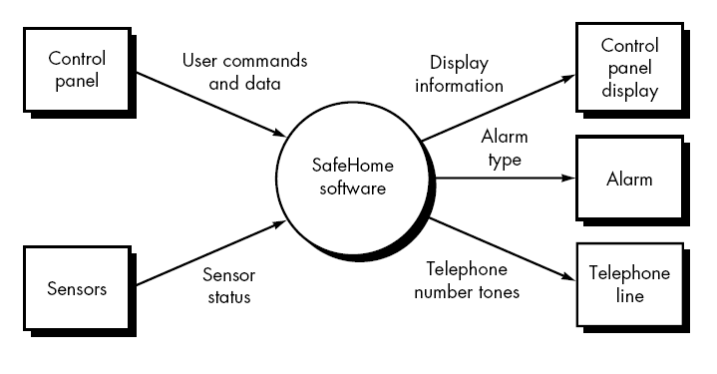
Level 0 - Diagram for SafeHome
During requirements analysis, more detailed flow models would be created for SafeHome.
In addition, control and process specifications, a data dictionary, and various behavioral models would also be created.

Slide 105
Design Steps
The preceding example will be used to illustrate each step in transform mapping.
The steps begin with a re-evaluation of work done during requirements analysis and then move to the design of the software architecture.

Slide 106
Step 1. Review the fundamental system model
The fundamental system model encompasses the level 0 DFD and supporting information. In actuality, the design step begins with an evaluation of both the System Specification and the Software Requirements Specification.
Both documents describe information flow and structure at the software interface.
Figure 1 and 2 depict level 0 and level 1 data flow for the SafeHome software.

Slide 107
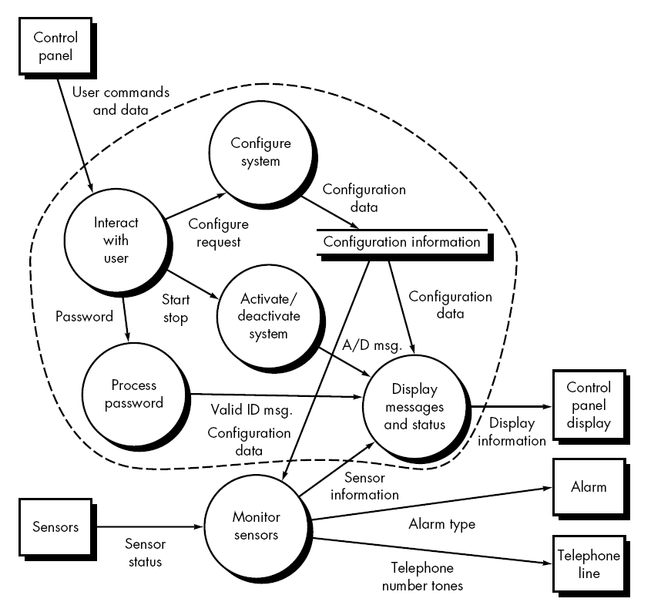
Level 1- Data flow for the SafeHome

Slide 108
Step 2. Review and refine data flow diagrams for the software
Information obtained from analysis models contained in the Software Requirements Specification is refined to produce greater detail. For example, the level 2 DFD for monitor sensors is examined, and a level 3 data flow diagram is derived .
At level 3, each transform in the data flow diagram exhibits relatively high cohesion.
That is, the process implied by a transform performs a single, distinct function that can be implemented as a module9 in the SafeHome software.
Therefore, the DFD in figure contains sufficient detail for a "first cut" at the design of architecture for the monitor sensors subsystem, and we proceed without further refinement.

Slide 109
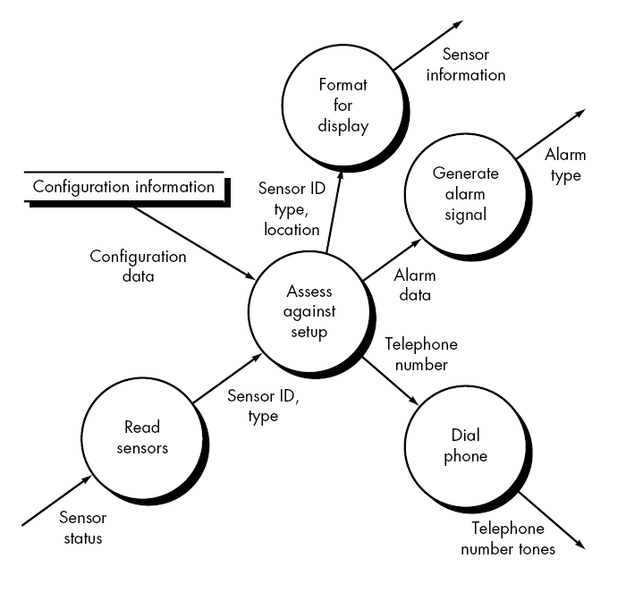
Level 2 - DFD for monitor sensors

Slide 110
Step 3. Determine whether the DFD has transform or transaction flow characteristics
In general, information flow within a system can always be represented as transform.
However, when an obvious transaction characteristic is encountered, a different design mapping is recommended.
In this step, the designer selects global (softwarewide) flow characteristics based on the prevailing nature of the DFD. In addition, local regions of transform or transaction flow are isolated.
These subflows can be used to refine program architecture derived from a global characteristic described previously.
For now, we focus our attention only on the monitor sensors subsystem data flow depicted in figure.

Slide 111
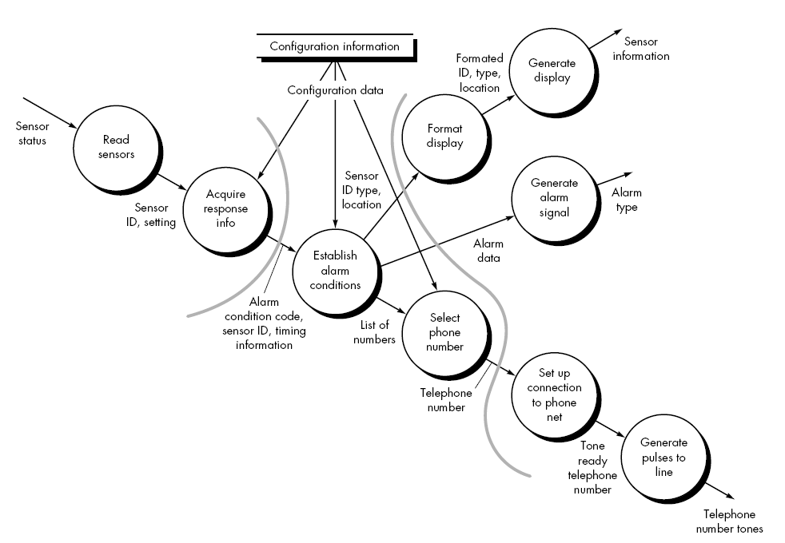

Slide 112
Step 4. Isolate the transform center by specifying incoming and outgoing flow boundaries.
In the preceding section incoming flow was described as a path in which information is converted from external to internal form; outgoing flow converts from internal to external form.
Incoming and outgoing flow boundaries are open to interpretation. That is, different designers may select slightly different points in the flow as boundary locations.
In fact, alternative design solutions can be derived by varying the placement of flow boundaries.
Although care should be taken when boundaries are selected, a variance of one bubble along a flow path will generally have little impact on the final program structure.

Slide 113
Step 5. Perform "first-level factoring." Program structure represents a top-down distribution of control.
Factoring results in a program structure in which top-level modules perform decision making and low-level modules perform most input, computation, and output work. Middle-level modules perform some control and do moderate amounts of work.
When transform flow is encountered, a DFD is mapped to a specific structure (a call and return architecture) that provides control for incoming, transform, and outgoing information processing.
This first-level factoring for the monitor sensors subsystem is illustrated in figure below.
A main controller (called monitor sensors executive) resides at the top of the program structure and coordinates the following subordinate control functions:

Slide 114
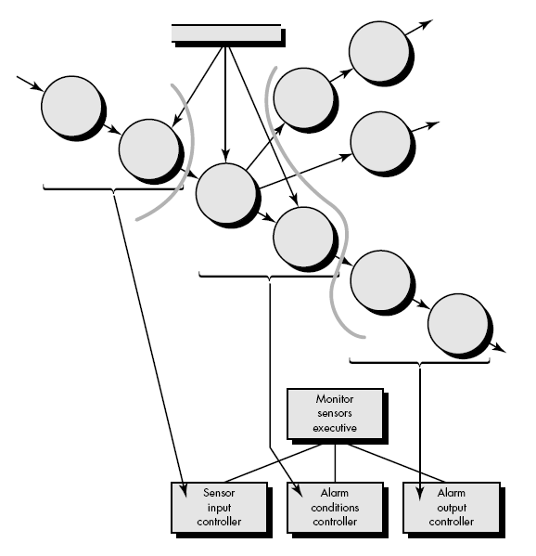

Slide 115
Step 6. Perform "second-level factoring." Second-level factoring is accomplished by mapping individual transforms (bubbles) of a DFD into appropriate modules within the architecture.
Beginning at the transform center boundary and moving outward along incoming and then outgoing paths, transforms are mapped into subordinate levels of the software structure.
The general approach to second-level factoring for the SafeHome data flow is illustrated in figure.

Slide 116
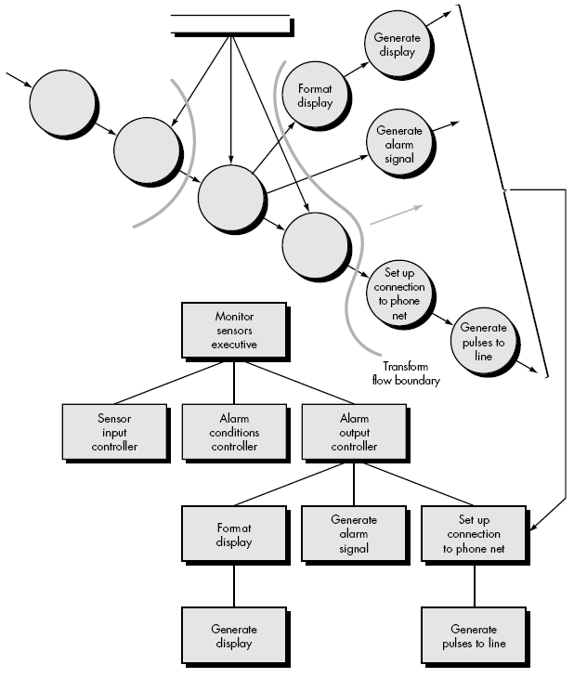

Slide 117
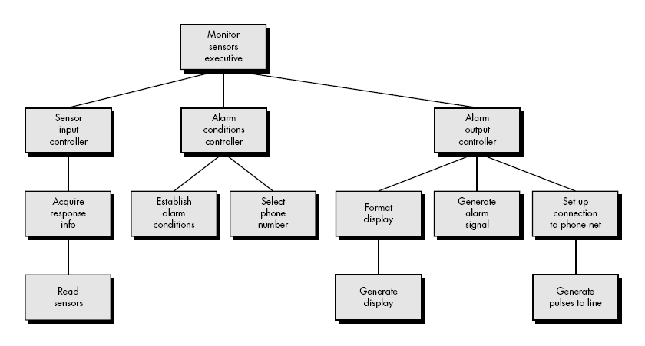
A completed first-iteration architecture is shown in figure

Slide 118
Step 7. Refine the first-iteration architecture using design heuristics for improved software quality.
A first-iteration architecture can always be refined by applying concepts of module independence .
Modules are exploded or imploded to produce sensible factoring, good cohesion, minimal coupling, and most important, a structure that can be implemented without difficulty, tested without confusion, and maintained without grief.

Slide 119
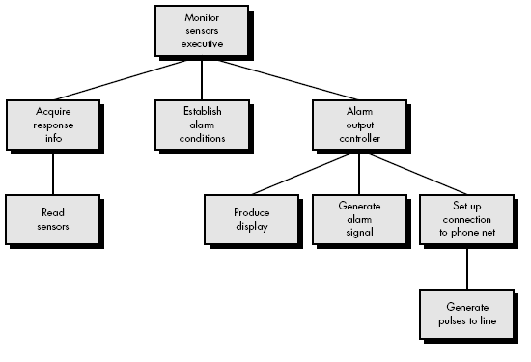
The refined software structure for the monitor sensors subsystem is shown in figure

Slide 120
User Interface Design

Slide 121
Interface Design
Easy to learn?
Easy to use?
Easy to understand?

Slide 122
Interface Design
Typical Design Errors
lack of consistency
too much memorization
no guidance / help
no context sensitivity
poor response
unfriendly

Slide 123
Golden Rules
Place the user in control
Reduce the user’s memory load
Make the interface consistent

Slide 124
Place the User in Control
Define interaction modes in a way that does not force a user into unnecessary or undesired actions.
Provide for flexible interaction.
Allow user interaction to be interruptible and undoable.
Streamline interaction as skill levels advance and allow the interaction to be customized.
Hide technical internals from the casual user.
Design for direct interaction with objects that appear on the screen.

Slide 125
Reduce the User’s Memory Load
Reduce demand on short-term memory.
Establish meaningful defaults.
Define shortcuts that are intuitive.
The visual layout of the interface should be based on a real world metaphor.
Disclose information in a progressive fashion.

Slide 126
Make the Interface Consistent
Allow the user to put the current task into a meaningful context.
Maintain consistency across a family of applications.
If past interactive models have created user expectations, do not make changes unless there is a compelling reason to do so.

Slide 127
User Interface Design Models
System perception — the user’s mental image of what the interface is
User model — a profile of all end users of the system
System image — the “presentation” of the system projected by the complete interface
Design model — data, architectural, interface and procedural representations of the software

Slide 128
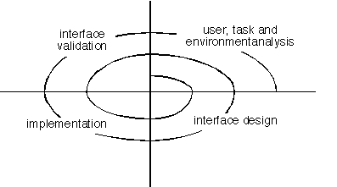
User Interface Design Process

Slide 129
Task Analysis and Modeling
All human tasks required to do the job (of the interface) are defined and classified
Objects (to be manipulated) and actions (functions applied to objects) are identified for each task
Tasks are refined iteratively until the job is completely defined

Slide 130
Interface Design Activities
Establish the goals and intentions for each task.
Map each goal/intention to a sequence of specific actions.
Specify the action sequence of tasks and subtasks, also called a user scenario, as it will be executed at the interface level.
Indicate the state of the system, i.e., What does the interface look like at the time that a user scenario is performed?
Define control mechanisms, i.e., The objects and actions available to the user to alter the system state.
Show how control mechanisms affect the state of the system.
Indicate how the user interprets the state of the system from information provided through the interface.

Slide 131


